Slide 1
Design for Rapid Manufacturing (DFRM)

Slide 2
DFAM
Design for manufacturing involves the practice of designing products to reduce manufacturing difficulties and cost, by optimizing the component for a particular manufacturing process.
Additive manufacturing processes are expensive compared to conventional processes the cost advantage can be achieved only through savings in material and reduced cycle time for production
Designing products, could make the manufacturing process easy
Guideline mistakenly assumed that several simple-shaped parts are inherently less expensive to manufacture than a single complex part and that any assembly costs are more than offset by the savings in part costs.
Assembled parts in the "right" design are significantly more expensive than the single part in the "wrong" design—even the piece part costs (neglecting tooling costs) are more expensive.

Slide 3
DFAM
Designers should tailor their designs to eliminate manufacturing difficulties and minimize costs.
DFAM can be categorized for manufacturing, assembly and performance.
Proposed three categories of AM related design methods comprising general design guidelines, modified conventional design theories & methodologies and DFAM.
The focus of their analysis was in attaining the desired mechanical properties by optimization of the structure of the component
The unique capabilities of AM technologies enable new opportunities for customization, improvements in product performance, multi-functionality, and lower overall manufacturing costs. It includes:
Shape complexity: it is possible to build virtually any shape, lot sizes of one are practical, customized geometries are achieved readily, and shape optimization is enabled.
Material complexity: material can be processed one point, or one layer, at a time, enabling the manufacture of parts with complex material compositions and designed property gradients.
Hierarchical complexity: hierarchical multi-scale structures can be designed and fabricated from the microstructure through geometric mesostructure (sizes in the millimeter range) to the part-scale macrostructure.

Slide 4
DFAM
Suitable CAD and DFM methods and tools can be developed, designers can design devices with significantly improved performance that fully utilize material, and with efficient manufacturing processes. With the shape, material, and hierarchical complexity capabilities, DFM can move from an emphasis on cost minimization to a focus on achieving unrealizable capabilities.
Synthesis of shapes, sizes, geometric mesostructures, and material compositions and microstructures to best utilize manufacturing process capabilities to achieve desired performance and other life-cycle objectives.

Slide 5
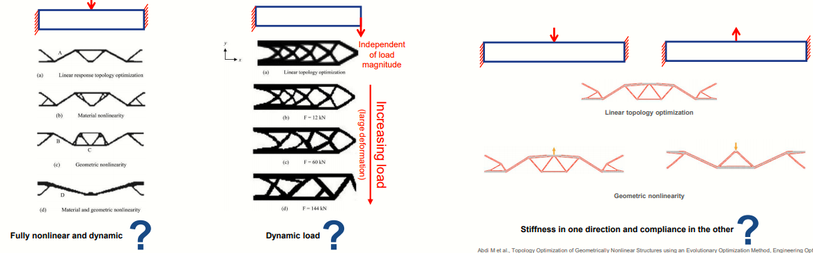
DFAM
Topology Optimization with nonlinear load case /requirements
Traditional design with linear/component loads and fine-tune the design later to meet sub-system/system-level nonlinear requirement strategy is not very effective for DFAM
Framing the design problem is very critical!
Post-design fine tuning might not be effective in meeting all requirement without changing the basic organic load path

Slide 6
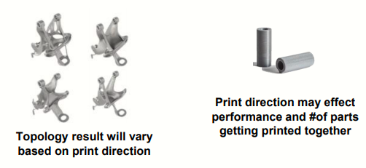
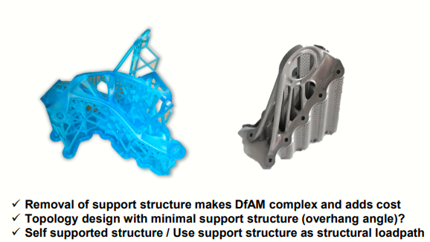
DFAM
Topology Optimization with AM specific constraints
Print Direction
Overhang Angle
Support Structure

Slide 7
DFAM
DFM/DEA is a primary driver of quality and cost improvement.
It impacts every system of the vehicle.
It is an integral part of engineering and manufacturing employee training.
It provides knowledge and capabilities for individuals and organizations.
It provides technical improvements to both product and process.
It's not an option—it's a requirement.

Slide 8
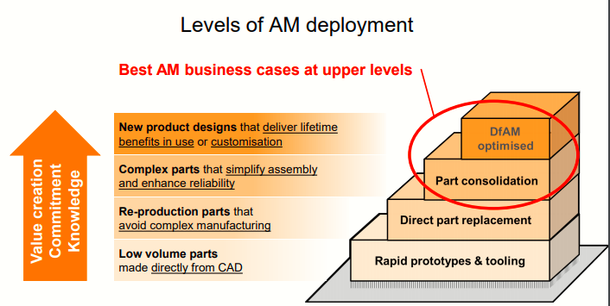

Slide 9
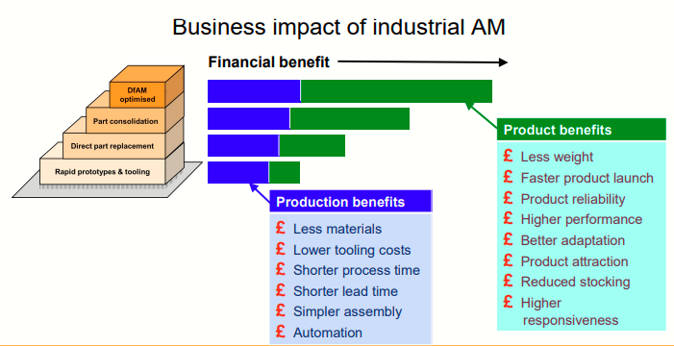

Slide 10
Why do we need design for AM?
Innovative AM product design
Lightweight AM parts are cheaper
Ideal AM product positioning
Build ability considerations
Residual stress
Orientation
Supports

Slide 11
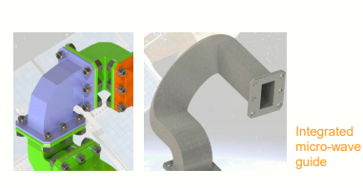
Innovative AM product design
Reduced weight
Reduced space claim

Slide 12
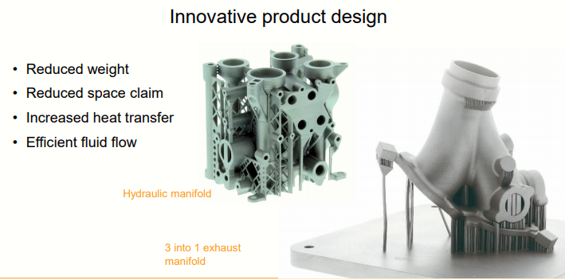
Innovative AM product design

Slide 13
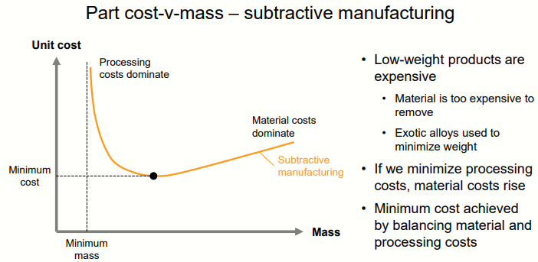
Lightweight AM parts are cheaper

Slide 14
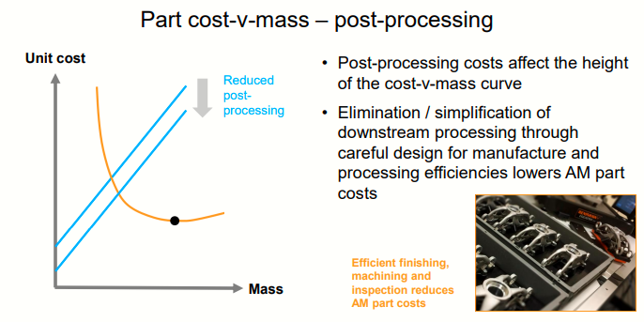
Lightweight AM parts are cheaper

Slide 15
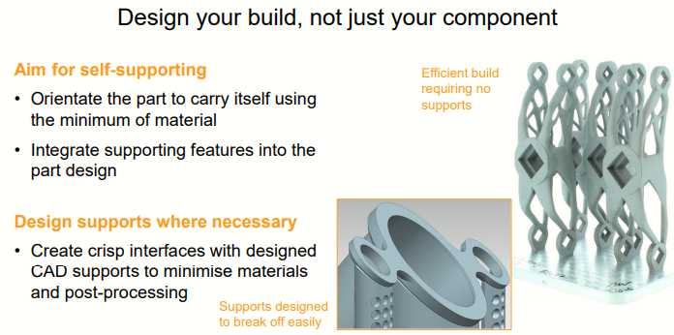

Slide 16
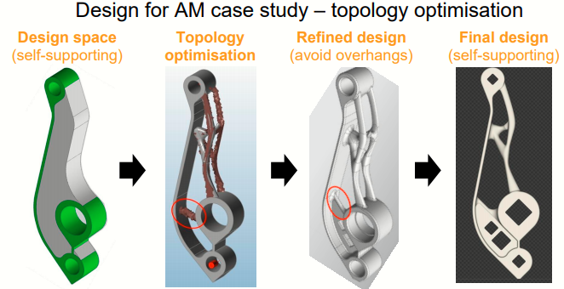

Slide 17
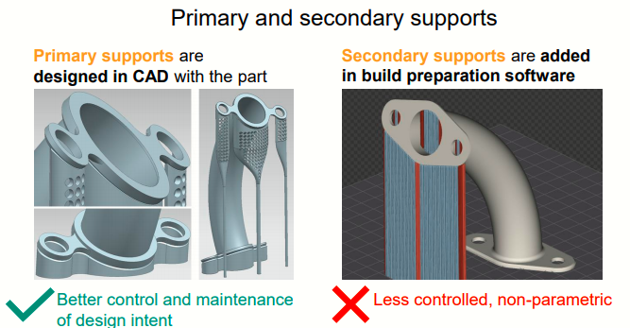

Slide 18
Complex Geometry
The propeller pinion used to connect the propeller shaft to the propeller blades. Faced significant challenges around its manufacture.
Originally produced via investment casting, Casting lead times were also quite long, due to the many manufacturing steps involved, and parts still required challenging and expensive machining before a pinion could be delivered to the customer.
AM was able to greatly simplify the manufacturing process, by bringing the fabrication process in-house, much more responsive to customer demands because they no longer have to worry about minimum lot sizes.

Slide 19
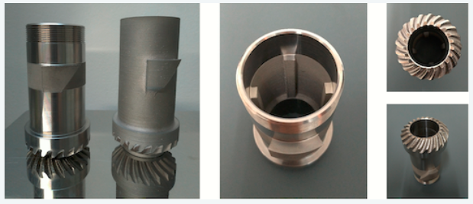
Complex Geometry
propeller pinion

Slide 20
Lightweight AM parts are cheaper
Ideal AM product positioning
Buildability considerations
Residual stress
Orientation
Supports

